Slide 1

Haar Cascade Classifier
Dr Grant Hair Phd in thuganomics

Slide 2
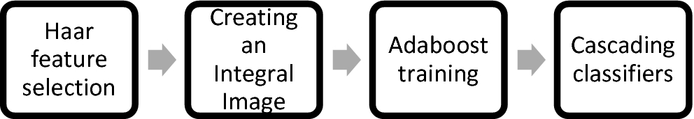
What?
http://nummist.com/opencv/Howse_ISMAR_20140909.pdf

Slide 3
Explain Yourself
Basically the Haar Cascade (Viola-Jones) classifier is a technique for feature detection within Computer Vision
This was used in the first real-time facial detection
At that point it was extremely computationally expensive
Although it has gotten so much better now.
https://docs.opencv.org/3.4/db/d28/tutorial_cascade_classifier.html

Slide 4
How does it work?
We start off with 2 folders:
One contains negative images (images that do not contain the thing you want to detect) and a bg.txt file that contains paths to all negative images
One contains positive images (images of things only that you want to detect, i.e close up faces etc)
The more the better
(note: they should be grayscaled, you an do this with opencv)
Part 1 – The Tale Of Two Folders

Slide 5
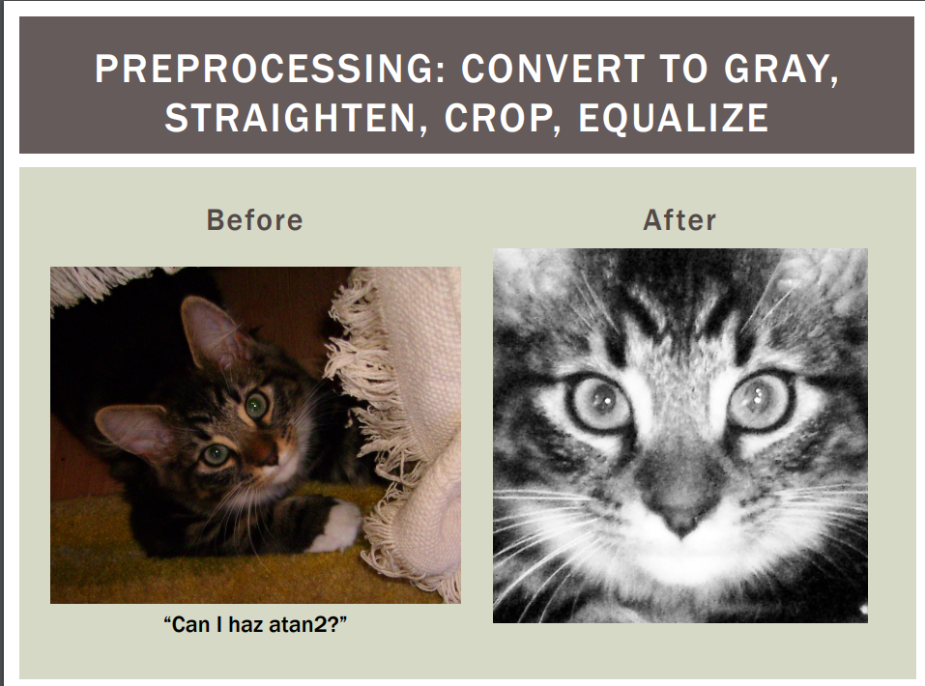
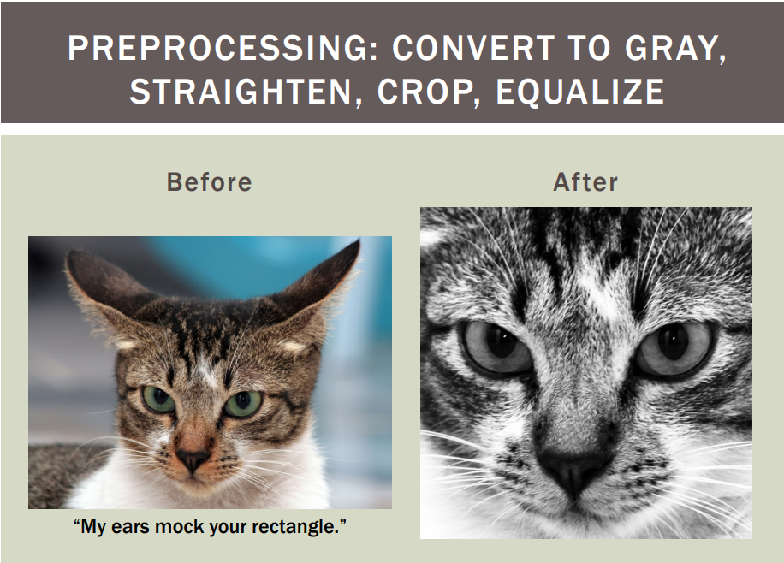
How does it work?
Part 1 – The Tale Of Two Folders

Slide 6
How does it work?
Ok, so we have our + and – images in their associated folders
We now want to use a tool called opencv_traincascade
This will allow us to train our Haar Cascade classifier
https://github.com/paschalidoud/opencv_traincascade
https://stackoverflow.com/questions/51970297/how-to-run-opencv-traincascade
https://docs.opencv.org/3.4/dc/d88/tutorial_traincascade.html
Part 2 – the command line tool that cooked my Pi

Slide 7
How does it work?
The output of the commands we learned about previously will give us an XML file
This will contain a lot of numbers and will be scary at first.
Do not fear we shall cover these later
Basically if you can add and subtract numbers you’ll get what it means
Part 3 – the one with the mental XML file

Slide 8
How does it work?
The language of choice for me when it comes to Computer Vision is Python(3)
Its helpful use of pip libraries make development a breeze
It also works perfectly with OpenCV my package of choice for all things computer vision.
https://www.python.org/downloads/
https://pypi.org/project/opencv-python/
Part 4 – coding with Guido

Slide 9
Gimme the detail
So now we know the helicopter overview lets go into some more detail.
I will cover:
“A hopefully simple to understand and maybe not wholesome look at the Haar cascade”
“Some random python codes that I wrote”
“I will show you my pi”
“A project that I done did real good”

Slide 10
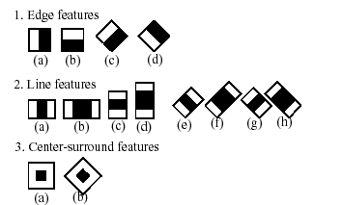
“A hopefully simple to understand and maybe not wholesome look at the Haar cascade”

Slide 11
“A hopefully simple to understand and maybe not wholesome look at the Haar cascade”
Basically the shapes above signify an area of pixels.
(Bearing in mind that our images are black and white)
Haar works by subtracting the sum of pixels under the white rectangle from the sum of pixels under the black rectangle
As edges will have more black pixels (shading) then the number of black pixels will be higher than the number of white pixels.
This is used to detect edges in certain features i.e the beginning of an eye or the bridge of a nose
These edges are known as “features”

Slide 12
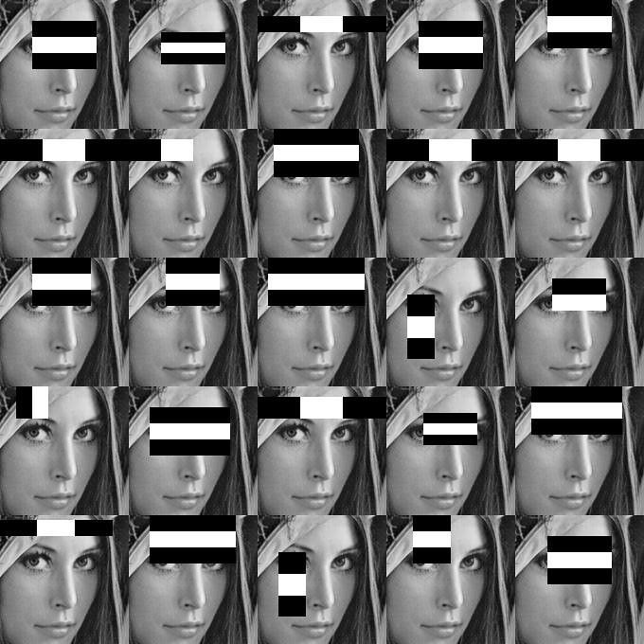
“A hopefully simple to understand and maybe not wholesome look at the Haar cascade”

Slide 13
“A hopefully simple to understand and maybe not wholesome look at the Haar cascade”

Slide 14
“A hopefully simple to understand and maybe not wholesome look at the Haar cascade”
This leads to complications
We now have too many “features”
How do we know which ones are “good” and which ones are “bad”
i.e
An eye and nose bridge have the same rough pixel density as a cheek but a cheek doesn’t provide us with much detail as our cheeks are all pretty much in the same place…. Except for the Kardashian’s

Slide 15
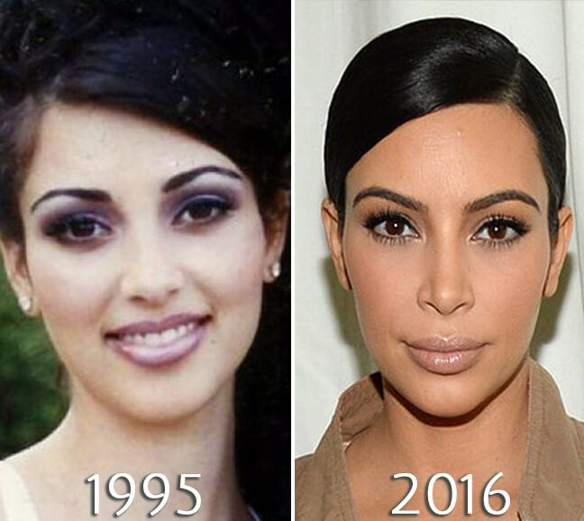
“A hopefully simple to understand and maybe not wholesome look at the Haar cascade”
Yes were looking at you Kim…

Slide 16
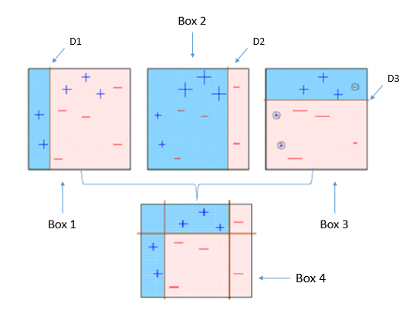
“A hopefully simple to understand and maybe not wholesome look at the Haar cascade”
So to resolve “the Kardashian issue”
We use a tool called Adaboost
This basically allows us to group our good features (eyes, noses, mouths, ears) together through years of training and development
We then discard the bad features (cheeks, hair, chins)

Slide 17
“A hopefully simple to understand and maybe not wholesome look at the Haar cascade”
After the good and bad features have been split we then write these to our XML file so we have a standardised way of saying these are the many many features that constitute a face.
We can say at this POI we expect the following pixel density.
Now we cant just have 1 image be the source of truth. So we run 1000s of images through this to give us a really great picture and allow us to build up our “stages”
As we build up our stages we whittle down the amount of “features” in an image from around 6000 to about 2 or 3

Slide 18
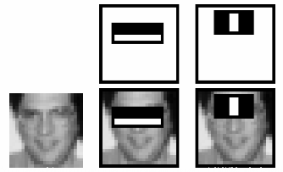
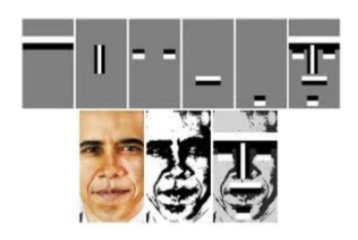
“A hopefully simple to understand and maybe not wholesome look at the Haar cascade”

Slide 19
“Some random python codes that I wrote”
import cv2 – pull in OpenCV after pip (like NuGet) install (like a using in C#)
faceCascade = cv2.CascadeClassifier('./haarcascade_frontalcatface_extended.xml’) – specify the Haar Cascade file I want to use
cap = cv2.VideoCapture(0) – open the camera and beginning capturing video
cap.set(3,640) # set Width
cap.set(4,480) # set Height
while True: - advanced python, only for true pros
ret, img = cap.read() – camera to image (frame by frame video)
gray = cv2.cvtColor(img, cv2.COLOR_BGR2GRAY) – grayscale input image from video feed

Slide 20
“Some random python codes that I wrote”
faces = faceCascade.detectMultiScale(
gray,
scaleFactor=1.2,
minNeighbors=5,
minSize=(20, 20)
) - Detects objects of different sizes in the input image. The detected objects are returned as a list of rectangles.

Slide 21
“Some random python codes that I wrote”
for (x,y,w,h) in faces: - points on each rectangle “feature” found
cv2.rectangle(img,(x,y),(x+w,y+h),(255,0,0),2) – place a rectangle on the feature
roi_gray = gray[y:y+h, x:x+w] – generates the region of interest on the grayscale image
roi_color = img[y:y+h, x:x+w] - generates the region of interest on the input image i.e video stream
cv2.imshow('CatDetectorV1',img) – opens a window for the video stream with rectangular overlay
cv2.destroyAllWindows() – closes open window with video stream

Slide 22
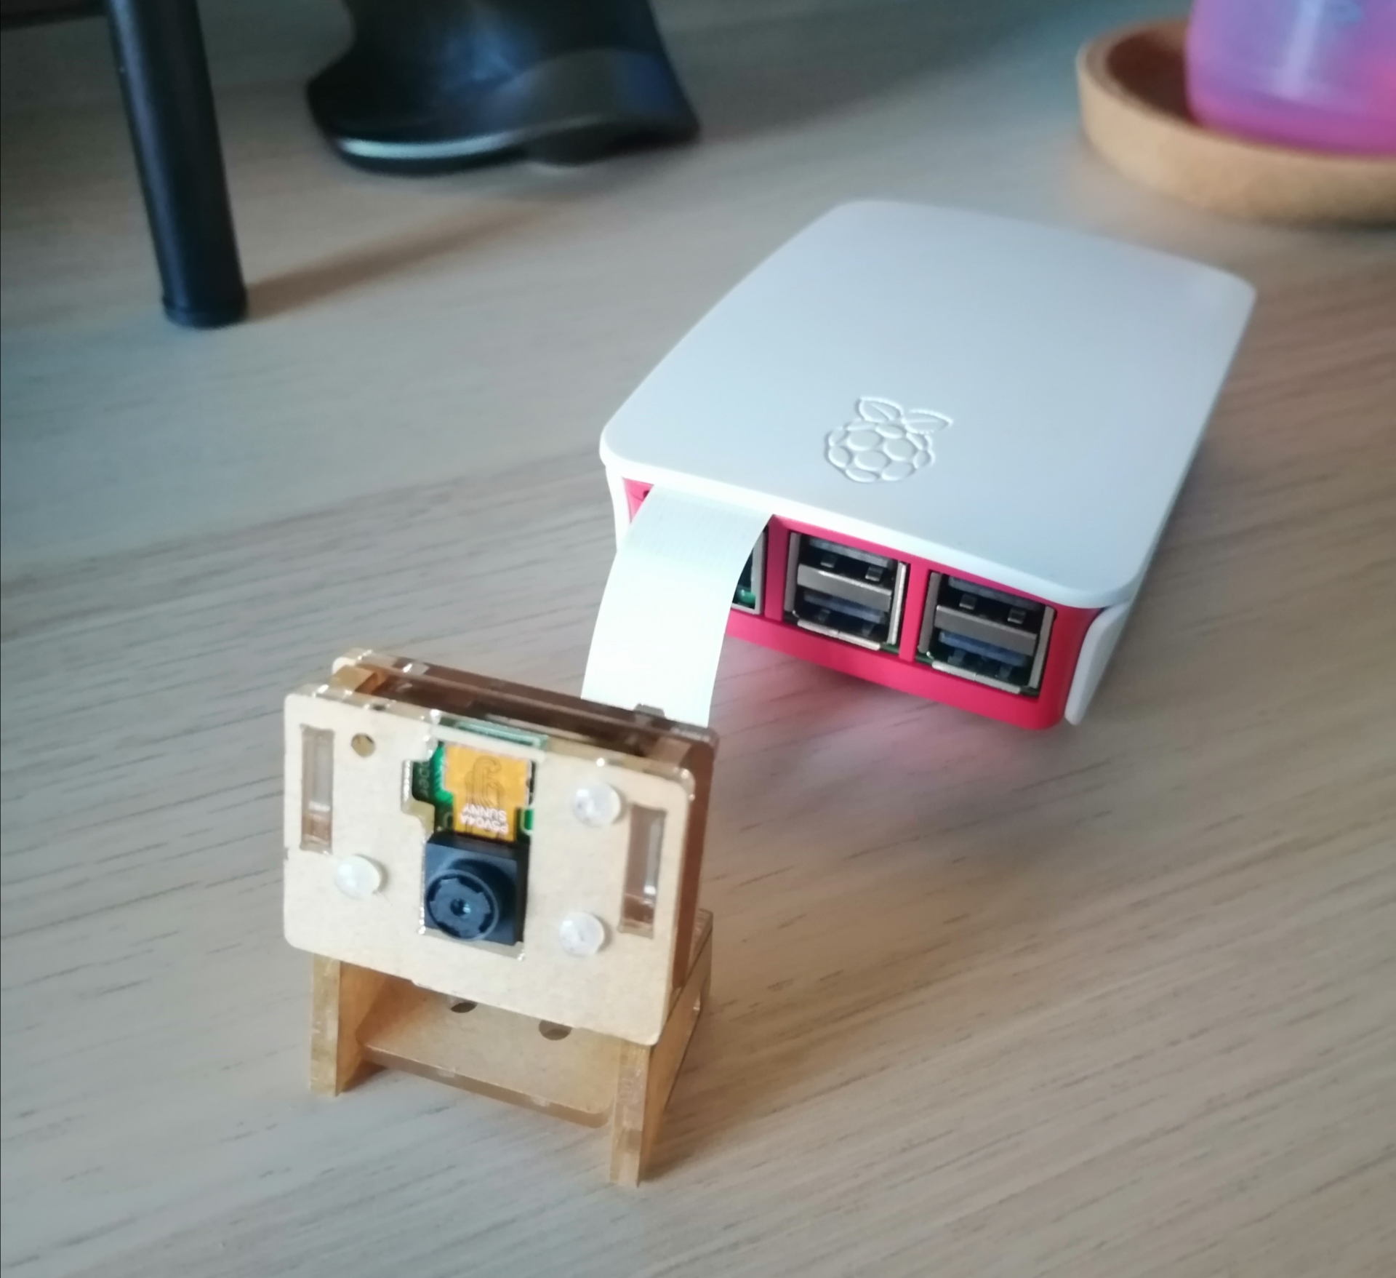
“I will show you my pi”
https://www.raspberrypi.org/products/raspberry-pi-3-model-b/?resellerType=home
https://www.amazon.co.uk/LABISTS-Raspberry-Camera-Module-OV5647/dp/B084X8MZ9J

Slide 23
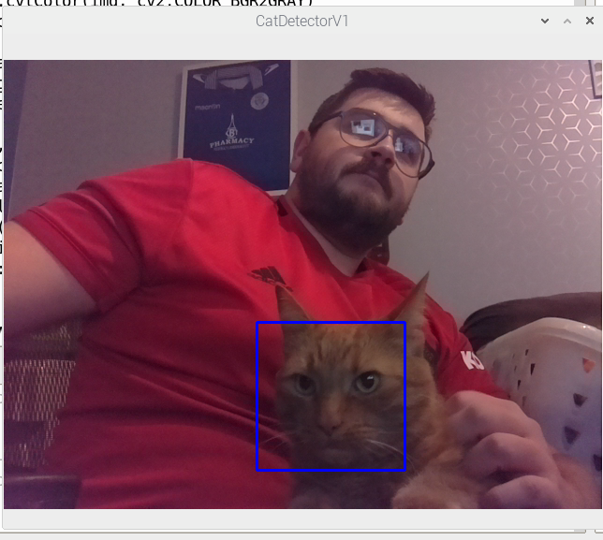
“A project that I done did real good”
https://github.com/GrantHair5/CatDetectorPy
This photo resulted in many battle wounds but it was all in the name of technology

Slide 24
Real good links
https://github.com/GrantHair5/CatDetectorPy
https://docs.opencv.org/3.4/db/d28/tutorial_cascade_classifier.html
http://www.willberger.org/cascade-haar-explained/
https://www.pyimagesearch.com/2016/06/20/detecting-cats-in-images-with-opencv/
https://www.hackster.io/mjrobot/real-time-face-recognition-an-end-to-end-project-a10826
https://docs.python.org/3/tutorial/
http://nummist.com/opencv/Howse_ISMAR_20140909.pdf

Slide 25
Thankyou
I hope this inspired you all to go away and make pointless things like a cat detector :D

